Slide 1
The Horizon Simulation Framework
Discussion with Boeing

Slide 2
Agenda
What is the Horizon Simulation Framework?
Background on Horizon development
Current projects
Appendix

Slide 3
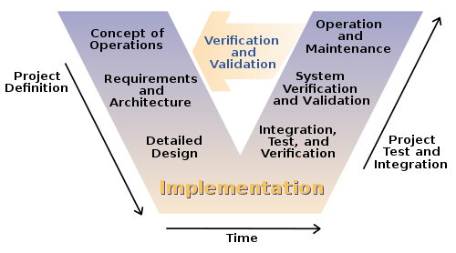
What problem is HSF trying to solve?
Verification and Validation of System Level Requirements can be difficult if the system is not operations
"Systems Engineering Process II" by Leon Osborne, Jeffrey Brummond, Robert Hart, Mohsen (Moe) Zarean Ph.D., P.E, Steven Conger https://commons.wikimedia.org/wiki/File:Systems_Engineering_Process_II.svg#/media/File:Systems_Engineering_Process_II.svg
Notes:
Main system level requirements can best be verified by simulation (Utility or Use Requirements)
Attack the problem by developing a model of the system that, when exercised, will simulate the behavior of the system over time

Slide 4
What is HSF?
Task Inputs
(Custom Task File)
Simulation Parameters (Custom Simulation File)
System Parameters (Custom Model File)
Horizon Simulation Framework
System Model
Modeling Utilities
Main Scheduling Algorithm
Subsystem
Subsystem
Subsystem
Scheduler/System Interface
Code Interactions
Final Schedule, State Data (Output)
Interface between Subsystems
Input/Output Interfaces
Notes:
A library of integrated software tools supporting rapid system-of-systems modeling, simulation and utility analysis
Provides an extensible and well-defined modeling capability concurrent with a scheduling engine to generate operational schedules of Systems-of-Systems with corresponding state data
Modular, Flexible with built-in utilities

Slide 5
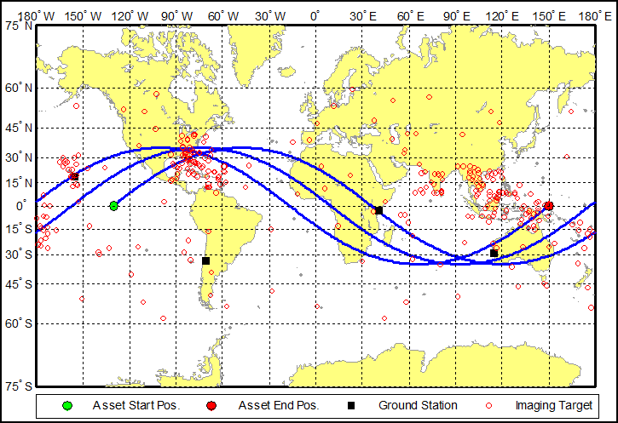
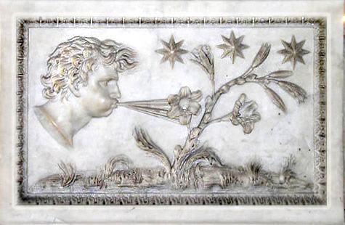
Example of using HSF
Aeolus: The Greek ruler of wind
Extreme-weather imaging satellite
Circular, 1000km, 35 degree inclined orbit
Simulation date: August 1st 2008 for 3 revolutions
Targets clustered into high-risk areas, including Southeast Asia and the Gulf of Mexico
Sensor has ability to generate data while in eclipse
A rev-in-the-life of the Aeolus constellation
Notes:
Aeolus Test Case – Rev. In The Life used to verify a utility based system-level requirement

Slide 6
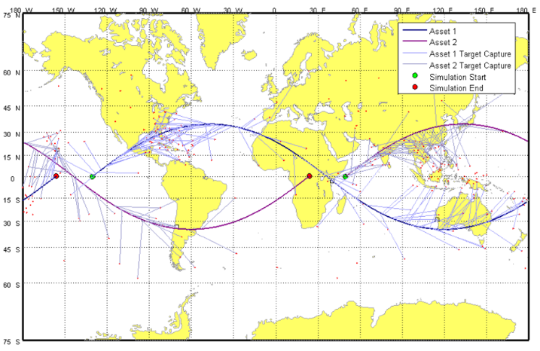
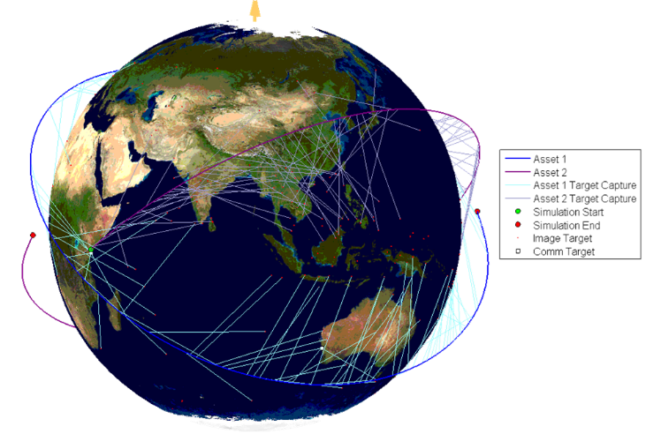
The Aeolus Results: Visualization
Matlab visualization of HSF simulation results

Slide 7
The Aeolus Model
ADCS
Actuates spacecraft to target in user defined slew time
EO Sensor
Takes data in user defined low, medium or high resolution (number of pixels)
SSDR
Records data in user defined storage buffer
COMM
Downlinks data at user defined downlink rate
Power
Maintains depth of discharge information from subsystem power usage and solar panel power in

Slide 8
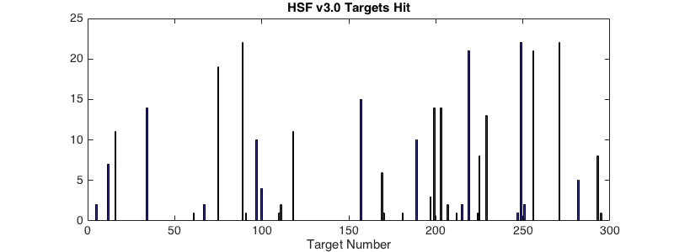
v3.0 Targets Hit
307 Hits

Slide 9
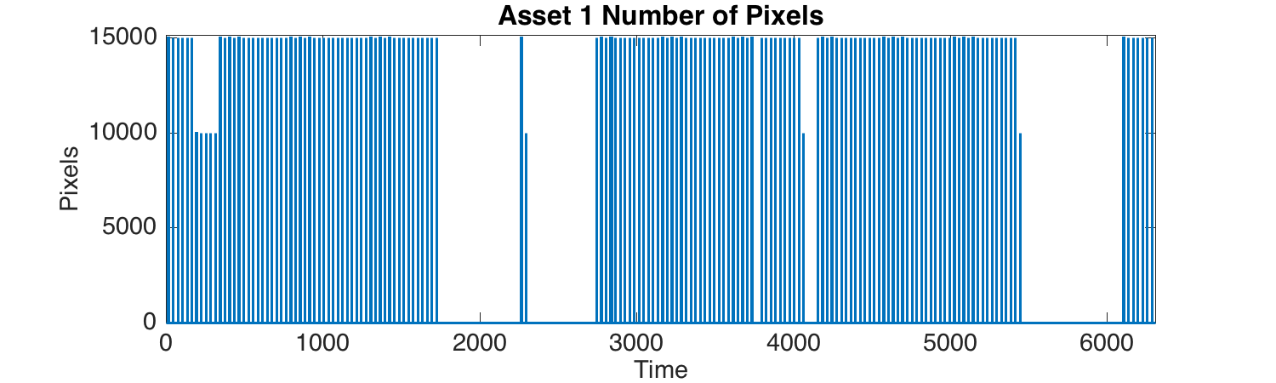
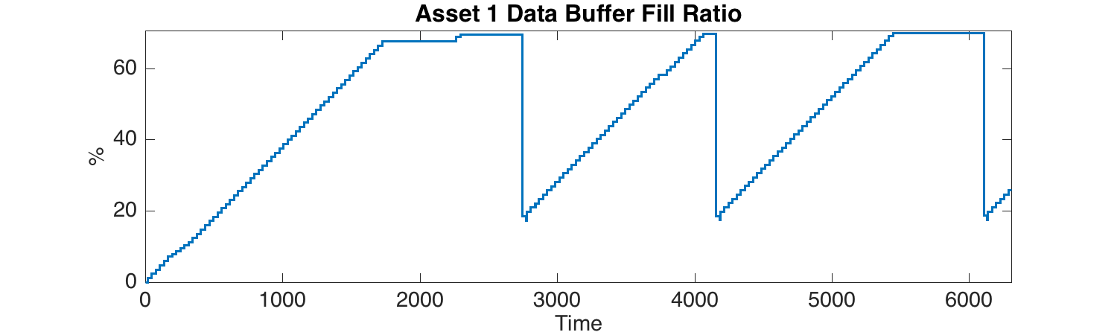
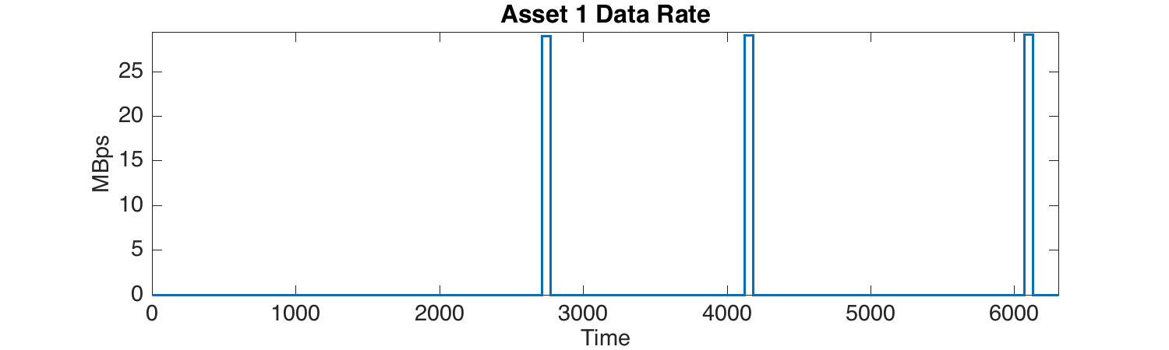
Asset 1 Data

Slide 10
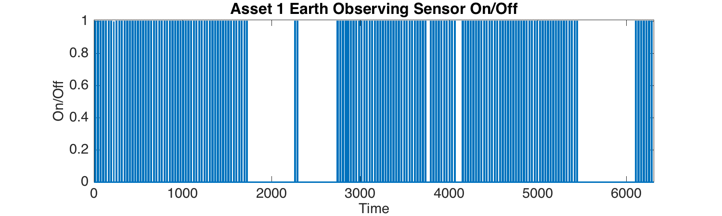
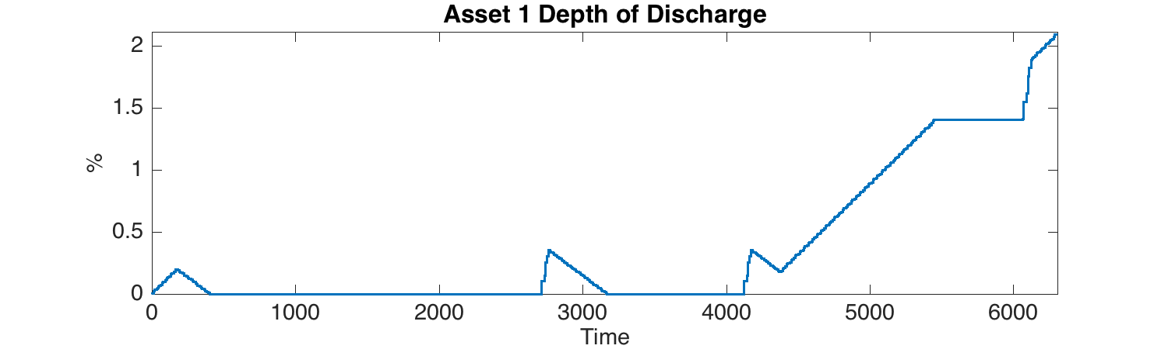
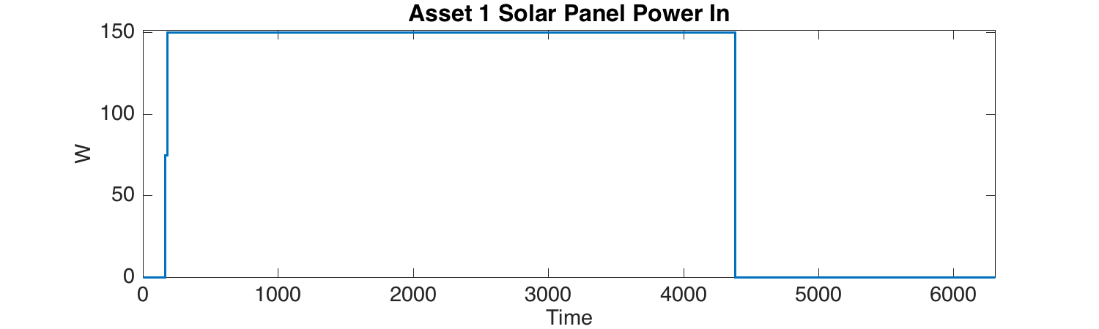
Asset 1 Data

Slide 11
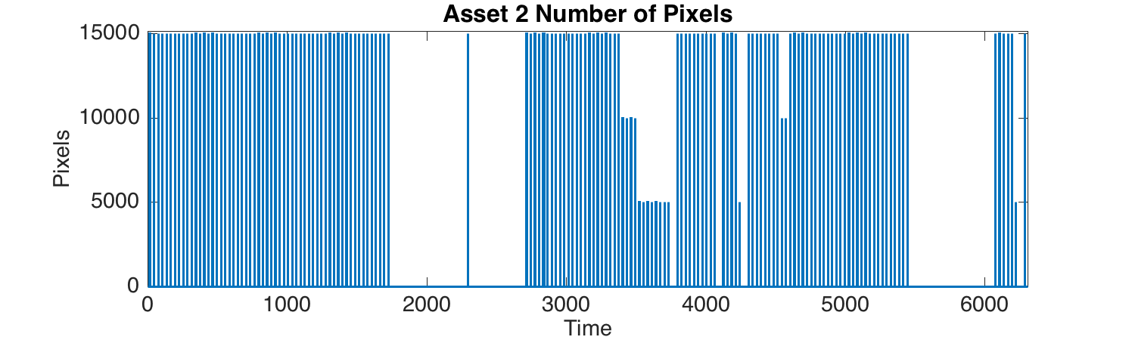
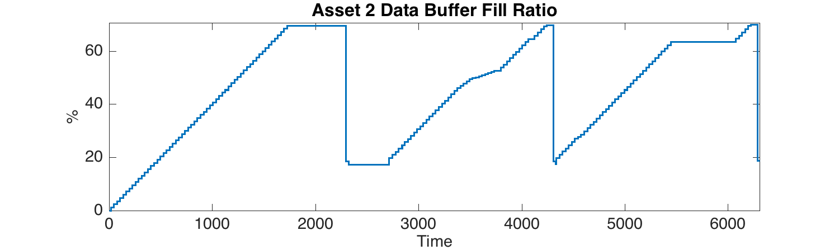
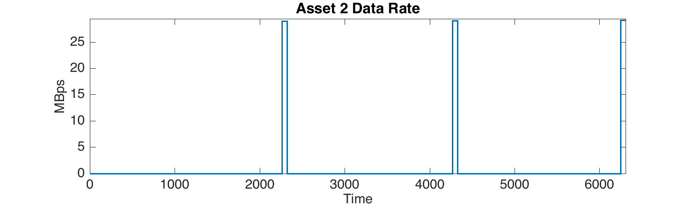
Asset 2 Data

Slide 12
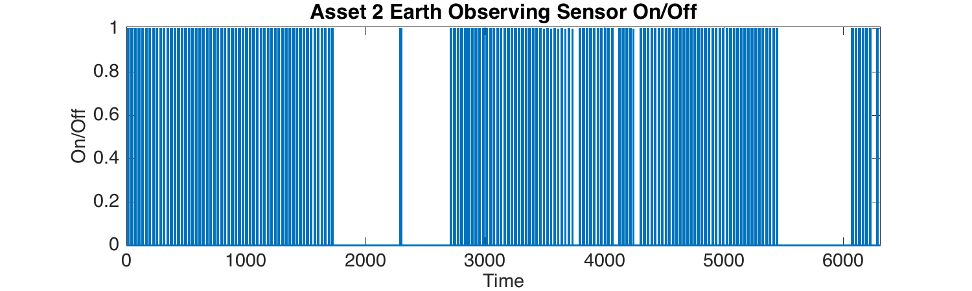
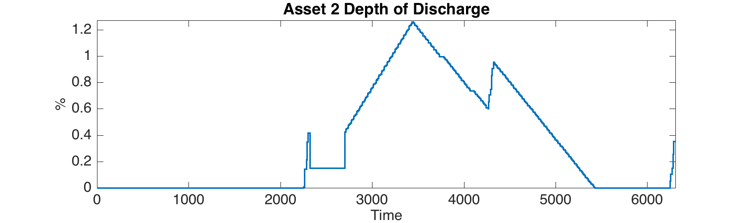
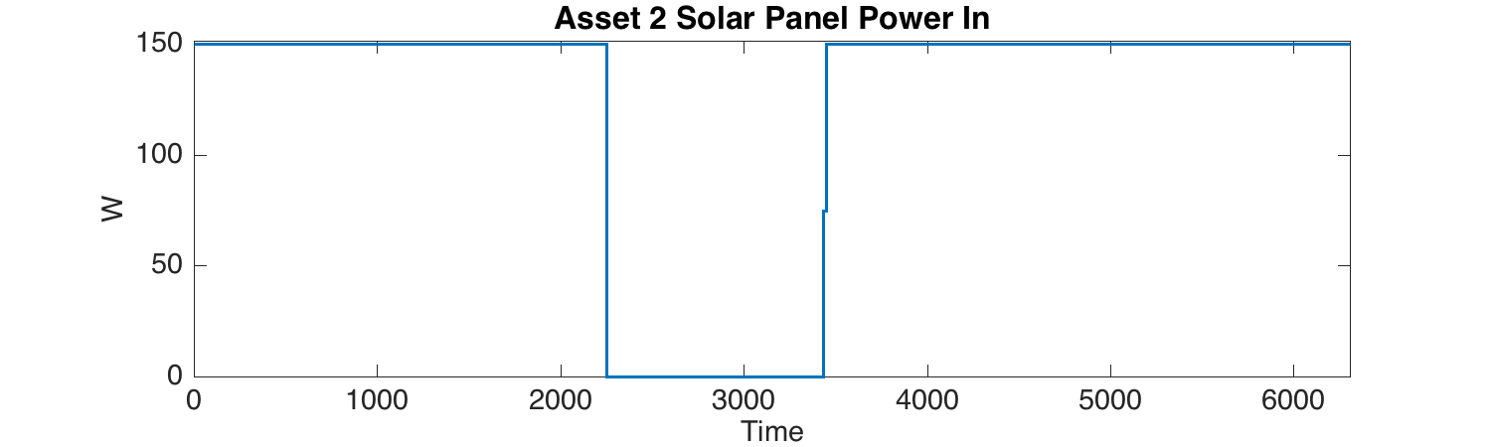
Asset 2 Data

Slide 13
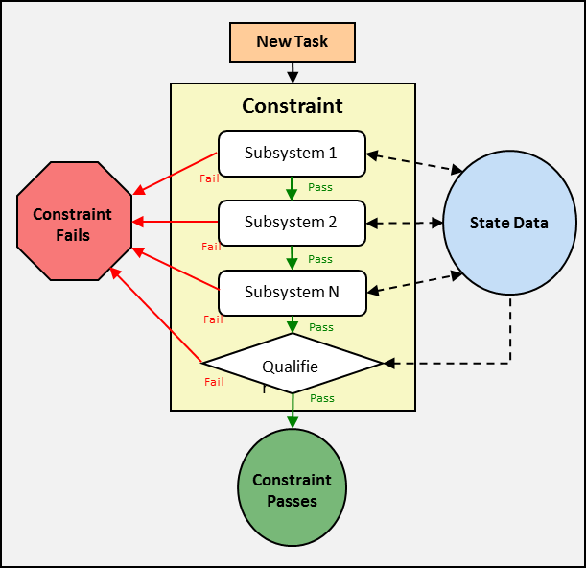
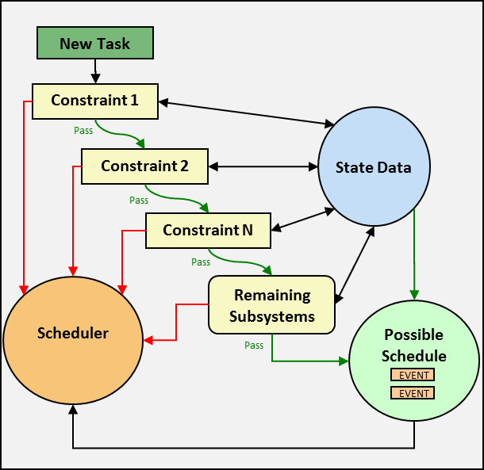
How Does HSF Work?
Subsystem 1
Subsystem 2
Subsystem 4
Subsystem 5
Subsystem 6
Subsystem 3
Subsystem 7
Subsystem 9
Asset 2
Asset 1
Subsystem 8
Subsystem 10
Subsystem 11
Asset 3
Subsystem 12
Notes:
Constraints – a limit on values of a system state variable
Dependency – describes the relationship between one or more subsystems
Asset – a collection of subsystems with some significant meaning to the modeling engineer

Slide 14
The Scheduler
Reference
1.
2.
3.
4.
5.
6.
7.
A
B
C
C
A
B
C
C
A
C
B
B
C
A
B
B
C
A
t₀ t₁ t₂
The process continues adding 4 more schedules but only 5 more elements in memory.
B
t₀ t₁ t₂

Slide 15
Progress since Fall 2015

Slide 16
Two Major Improvements
Redeveloped the architecture of HSF as a series of stand-alone projects using C#
More maintainable, learnable and usable
Better support for unit testing
Uniform Coding Style
Take advantage of .NET framework and Github source control
Implemented Python scripting support

Slide 17
One Major Enhancement
Dynamic constraint checking
The constraint and subsystem checking order can be updated dynamically
Constraint failure feedback
Information on the cause of each constraint failure is provided to user for design consideration

Slide 18
Current/Future Work
Optimizing code
Adding multithreading
Minimizing memory allocation
Developing MBSE/sysML based model schema
Building additional models for reuse
GUI integration
Unit testing is on going

Slide 19
Moving Forward
Three current graduate students working on HSF
PloySim club
Many undergraduates looking for projects
Developing elective course in Modeling and Simulation
We are looking for projects/ideas

